Slide 1
Immigration Issues in Employment
Karl R. Ulrich, Esq.
June 22, 2023

Slide 2
Today’s Agenda
Overview of Foreign Worker Categories
Overview of Petition Process
Employer Immigration Compliance Issues
I-9/E Verify
Employment Regulation and the Foreign Worker

Slide 3
Government Agencies: Oversight and Enforcement
United States Citizenship and Immigration Service (“USCIS”)
Responsible for petition and approval process
Department of Labor (“DOL”)
Responsible for confirming compliance with prevailing wage and labor certifications
Department of State (“DOS”)
Responsible for issuance of actual visa (generally through network of foreign consulates)
Immigration and Customs Enforcement (“ICE”)
Customs & Border Protection (“CBP”)

Slide 4
Common Business Categories
B Visas – Business Traveler
H Visas – Temporary Workers
H-1B - Professionals in a Specialty Occupation
H-2A – Temporary Agricultural Workers
H-2B – Non-Agricultural Temporary Worker
H-3 - Trainees
L Visas – Intracompany Transferees
O Visas – Aliens of Extraordinary Ability
TN Visas – NAFTA Professional Workers
Student Visa/CPT/OPT
Green Card (Permanent Resident Status)
Other Categories

Slide 5
L Visa (Intracorporate Transfers)
Petition filed by employer
L-1A – transferee executive/manager
L-1B – transferee specialized knowledge
Must be “qualifying relationship” between U.S. and foreign entity
Periods of stay:
- L-1A – initial 3 yrs./max. 7 yrs.
- L-1B – initial 3 yrs./max 5 yrs.
Employee must have been with foreign entity at least 1 of previous 3 yrs.

Slide 6
H-1B Visa
Petition filed by “sponsoring” employer
“Specialty Occupation” – job specific
3 years (extended another 3 yrs.)
Limited availability (65,000 + 20,000 for advanced degrees)
Employment starts Oct. 1; earliest filing allowed April 1
Labor Condition Application (LCA) required
Portable (can be transferred to another employer)

Slide 7
TN NAFTA Professionals
Citizens of Canada or Mexico
Qualifying professions listed in regulations
Position in U.S. actually requires this background
Have received a full/part time position w/U.S. employer (no self-employment)
Individual has the qualifications required of the position
Canadians may demonstrate eligibility at port of entry without prior processing
Mexican citizens must apply for visa at U.S. consulate in Mexico before entry
Initial period of stay: 3 yrs. (may be extended without limit)
Employers may seek pre-approval from USCIS

Slide 8
Student Work Status
Foreign students in U.S. have limited work eligibility (F and M visas)
Curricular Practical Training (“CPT”) (F visa only)
Optional Practical Training (“OPT”): pre or post completion total 1 yr. eligibility
STEM OPT extension – up to additional 24 months

Slide 9
Common Pathway
Student F visa
OPT (12 mo.)
STEM Extension (add’l 24 mo.)
H-1B (3 – 6 years)
Permanent Residency - Green Card

Slide 10
Permanent Resident (Green Card)
EB-1 – Priority Workers: “extraordinary ability in sciences, arts, education, business or athletics”
EB-2 – Positions requiring advanced degrees or “exceptional ability”/ NIW
EB-3 – Professionals, other skilled workers
EB-4 - Special immigrants: religious workers, special immigrant juveniles, broadcasters
EB-5 – Immigrant investor program

Slide 11
Permanent Labor Certification
Prerequisite to some GC categories
DOL must certify:
- Not sufficient U.S. workers able, willing & qualified
Foreign workers will not adversely affect wages of similarly employed U.S. workers
Labor Certification must be obtained prior to Green Card application
Can take a year or more to complete

Slide 12
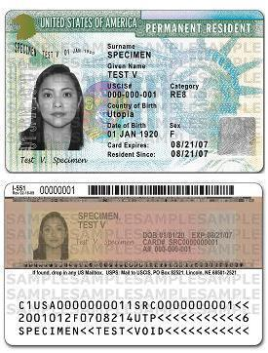
U.S. Permanent Resident “Green” Card Sample

Slide 13
Loss of permanent Residency – Green Card
Living outside of U.S. for 1 year or more
- Can obtain “re-entry permit” in advance
- Can obtain returning resident visa if away 2 years or more
Voluntary surrender of status
Misrepresentation or fraud
Criminal Convictions (e.g., violent crimes, crimes of moral turpitude, aggravated felonies)

Slide 14
Employment Discrimination and the Foreign Worker
Illegal to discriminate on basis of national origin, citizenship or immigration status
English-only work rules may be discriminatory unless required for safety, efficiency or other non-discriminatory reasons
May not apply different hiring criteria/ procedures to eligible/qualified foreign workers
May not request more or different documents than are required for verification purposes, reject reasonably genuine-looking documents.
May not knowingly hire, recruit for a fee or refer for a fee unauthorized non-citizens

Slide 15
OSHA and the Foreign Worker
OSH Act protects all employees working in U.S. and U.S. territories
Training must be in language and vocabulary “understandable to employee”
Work Instructions – same
Lockout/Tagout/Respiratory Protections/ Blood Borne Pathogens
Safety Rules

Slide 16
Modern Continental Construction Co. v. OSHRC (1st Cir. 2002)
Employer has a duty to communicate work/safety rules using language understandable to non-English speaker

Slide 17
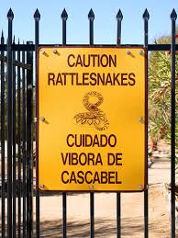
Sec. of Labor v. Star Brite Construction Co. (OSHRC 2001)
Employee misconduct defense to OSHA citation failed when work rules not translated into foreign language for those with limited English proficiency

Slide 18
Employer Immigration Compliance
I-9 Compliance
Employers are obligated to verify the identity and employment eligibility of all employees within 3 days of hire
I-9 is the form used for the verification process
E-Verify
Electronic eligibility verification service
Generally voluntary, but mandatory under certain circumstances
Some states require it by law – Ohio does not
Federal contractors and subcontractors

Slide 19
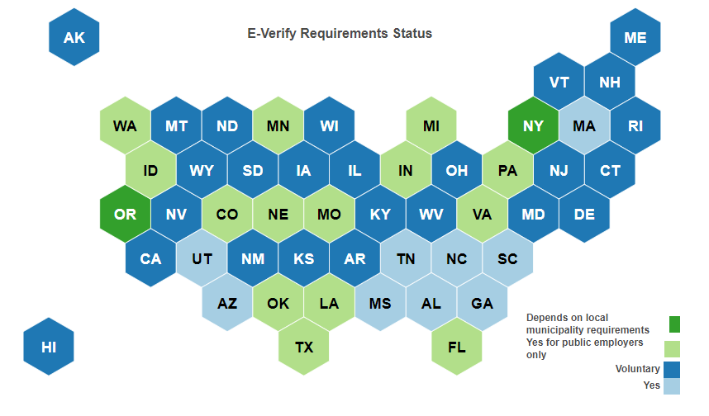
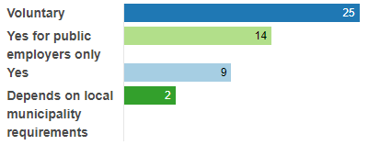
Map of States with E-Verify Laws
States with Mandatory E-Verify -
Alabama, Arizona, Georgia, Massachusetts, Mississippi, North Carolina, South Carolina, Tennessee, and Utah.
https://worldpopulationreview.com/state-rankings/e-verify-requirements-by-state Updated: February 2023

Slide 20
The I-9 Requirements
Apply to all employers regardless of size
Must use for each new hire
All employees (citizens and noncitizens) not independent contractors
Only if physically working on U.S. soil

Slide 21
Completing the I-9
Employee completes Section 1 at time of hire (by 1st day of employment)
Document originals are required for review
Must accept any documents on list if “reasonably appear” to be genuine
Employee must be physically present with document examiner during document review
Attestation and examination of documents must be by same person
If make copies, do so for all employees (E-Verify requires customer copies be kept)

Slide 22
Reverification – I-9 Documents
If work authorization has expiration, may need to reverify before expiration
Use Section 3
May not consider expiration date when determining if qualified for hire

Slide 23
Retention / Recordkeeping
Retain I-9s for 3 years from date of hire or for 1 year after employment ends, whichever is later

Slide 24
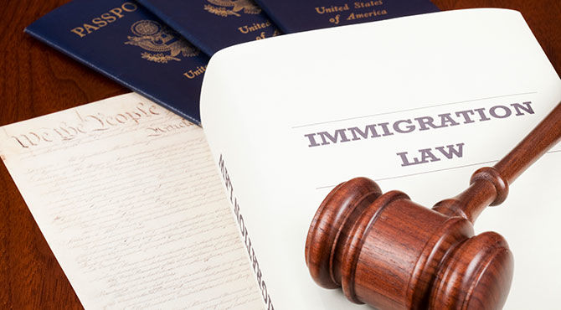
Penalties for Non-Compliance
Civil fines ($252 - $2,507 per non-compliant form)
Illegal hiring ($627 - $25,076)
Criminal penalties (for pattern and practice violations)
Debarment from government contracts
Court order of compliance

Slide 25
QUESTIONS?
Karl R. Ulrich, Esq.
kulrich@ssdlaw.com

